Slide 1
UMD & Mobile
Industry MFG Capability
CSTI - CME : Q1’07
Contributors
Doug Powell
Chris Combs
FK Yap
Connos Tai
Eric Brigham
Todd Harris
Dan Burkholder
JJ Grealish
Kevin Byrd

Slide 2
Executive Summary
Roadmap vs. Customer Manufacturing Capability
Customer Impact
  No current customer mfg equipment capability gap through 2008 for mobile and UMD
  Minor capability gaps identified in 2009 for USFF roadmap
    Placement equipment at two UMD customer sites are not capable for Intel’s most aggressive roadmap. (Capability exists at mobile ODMs)
    As PCB pad size decreases, increased risk of pad lifting during rework
    Increasing board density limits test access and coverage
Mitigation Strategy
  Influence placement equipment upgrades by communicating capability gaps.
  Develop material / rework process for decreased pad diameters
  Enable boundary scan and continue test probe development (Idaho) for 3 mil trace test pad
Strategy identified to address customer mfg capability gaps

Slide 3
UMD Content
Roadmap Assumptions
Package Attributes versus Capability
  Pitch and Ball Size Impacting Placement
  Pitch and PCB Pad Size Impacting Rework
  Pitch and PCB Trace Width Impacting Electrical Test
ODM / OEM Assembly Capability (63% of market)
  Quanta - ODM
  Inventec - ODM
  Asustek - ODM
  LGE - OEM
  Samsung - OEM

Slide 4
Mobile Content
Roadmap Assumptions
Package Attributes versus Capability
  Pitch and Ball Size Impacting Placement
  Pitch and PCB Pad Size Impacting Rework
ODM Assembly Capability (85% of 2006 market)
  Quanta 35% MSS
  Compal 20% MSS
  Inventec 11% MSS
  Wistron 11% MSS
  Asustek 8% MSS

Slide 5
Backup

Slide 6
USFF Roadmap Assumptions
 | McCaslin | Menlow | Moorestown
Year | 2007 | 2008 | 2009
Minimum Pitch | 0.593mm | 0.593mm | .483 - .5mm
Smallest Ball Diameter | 14 mils | 14 mils | 10 - 12 mils
Smallest SRO | 300 | 305 | 200 - 254
Smallest PCB Pad Size | 12 mils | 12 mils | 10 mils
PCB Trace Width for Test Probe | 4 mils | 4 mils | 3 - 3.5 mils
Roadmap information is tentative and subject to change

Slide 7
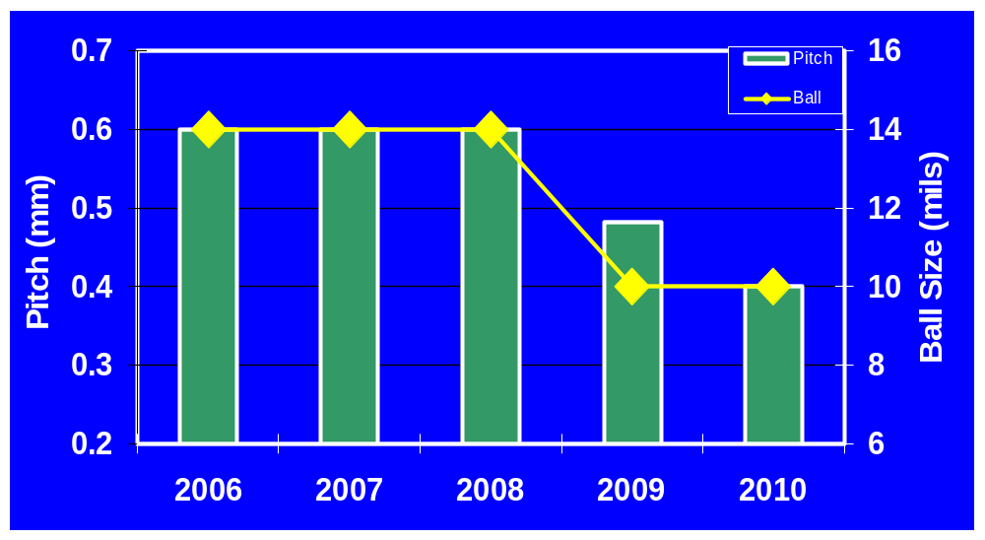
UMD Pitch and Ball Size Trend
Impact on Placement
LG / Samsung ‘07 Capability
Quanta / Inventec ‘07 Capability
Equipment Specs
The OEM/ODM capability is based on placement machine’s manufacturing specifications.
Pitch at or slightly above minimum capability will need to be validated.
2010 trend numbers based on TUFF.
OEMs will need to update placement equipment for sub 0.5mm pitch

Slide 8
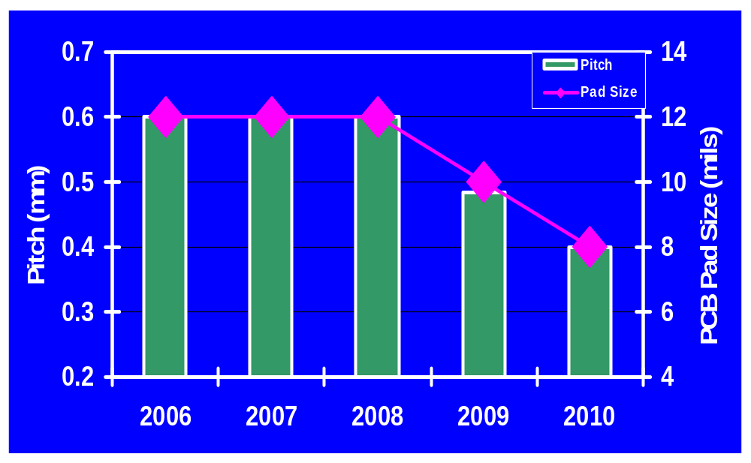
UMD Pitch and PCB Pad Size Trend
Impact on Rework
Decreasing Capability
McCaslin customers have shown rework capability at 0.6mm pitch
Pad lifting becomes more prevalent on smaller diameter pads

Slide 9
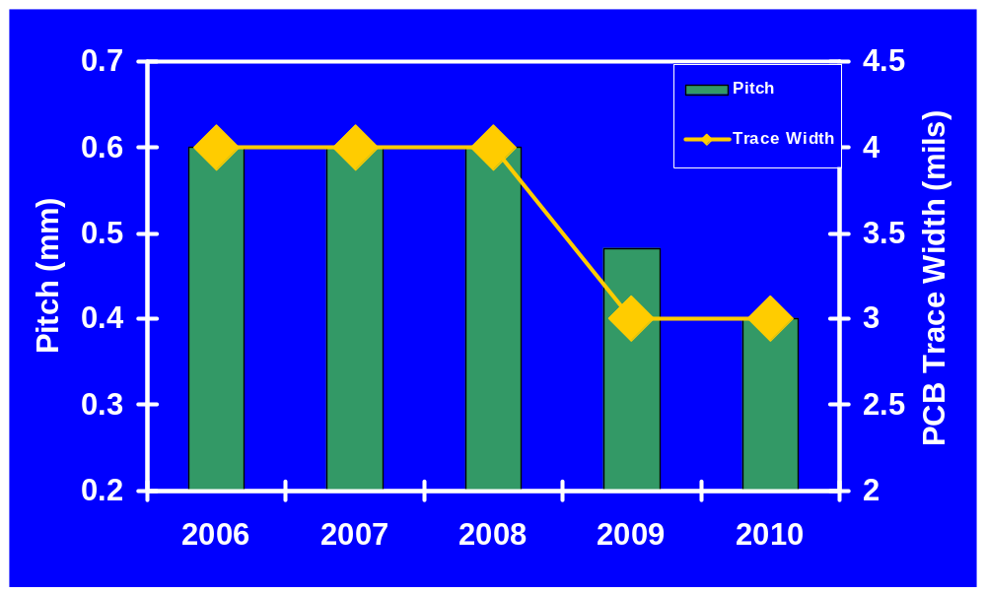
UMD Pitch and PCB Trace Width Trend
Impact on Test
Industry Capability
Planned Development
Stretch Goal
Development of Idaho bead probe test technology will need to continue. Soldermask registration will be critical.

Slide 10
UMD Placement Equipment
 | LGE (OEM) | Samsung (OEM) | Quanta (ODM) | Quanta (ODM) | Inventec (ODM) | Asustek (ODM)
Location | Seoul | Suzhou | Shanghai QSMC | Shanghai QSMC | Shanghai | Taipei
Placement Machine | Panasonic MPAV2 | Panasonic MPAV | Fuji QP341 | Fuji NXT | Universal GSM | Universal GSM
Accuracy | 0.040mm @ 3σ | 0.040mm @ 3σ | 0.066mm @ 3σ | 0.066mm @ 3σ | 0.050mm @ 5σ | 0.050mm @ 5σ
Minimum Ball Diameter | 0.300mm | 0.300mm | 0.250mm (10 mils) | 0.250mm (10 mils) | 0.132mm | 0.132mm
Minimum Pitch | 0.500mm | 0.500mm | 0.400mm | 0.400mm | 0.264mm | 0.264mm
Numbers are based on equipment mfg’s specifications
Below .300mm (12 mil) ball diameter, drives ball recognition issue
LGE and Samsung will need to upgrade equipment to assemble below 0.5mm pitch (2009?) or move production to more capable facility

Slide 11
Menlow Package Attributes
Package Attribute | Silverthorne | Poulsbo | Bangor
Package Technology | 1266 FCBGA8 | 861 FCBGA3 | 861 FCBGA3
Package Size (mm) | 13x14 | 22x22 | 15x15
Die Size (mm) | 3.27x7.94 | 10.79x10.4? | 5.46x5.33
Die/Substrate (um) - Product | 780/400 | 780/400 | 300/?
Die/Substrate (um) - TV | 400/400 | 400/400 | 300/?
Package Layer Count | 6 | 8 | 4
Package Interface | NiPdAu | NiPdAu? | NiAu
Ball Pitch (mm) | 0.593 | 0.593 | 0.80
Ball Pattern | Interstitial (full grid turned 45 deg) | Variable grid | ?
Ball Count | 360 | 1249 | 286
Ball Diameter (mils) | 14 | 14 | 20
SRO (um) | 305(12mil) | 305 (12mil) | ?
LF SLI / Ball Composition | SAC405 | SAC405 | SAC405
Corner Design Rule |  | 4-6 SCBs per Corner | ?
Die Shadow nCTF | N-2, N+1? | None | ?
BLUF | Reworkable BLUF | Reworkable BLUF | Reworkable BLUF
Based on Package Attributes, Industry Capability Exists for ’08 UMD Platform

Slide 12
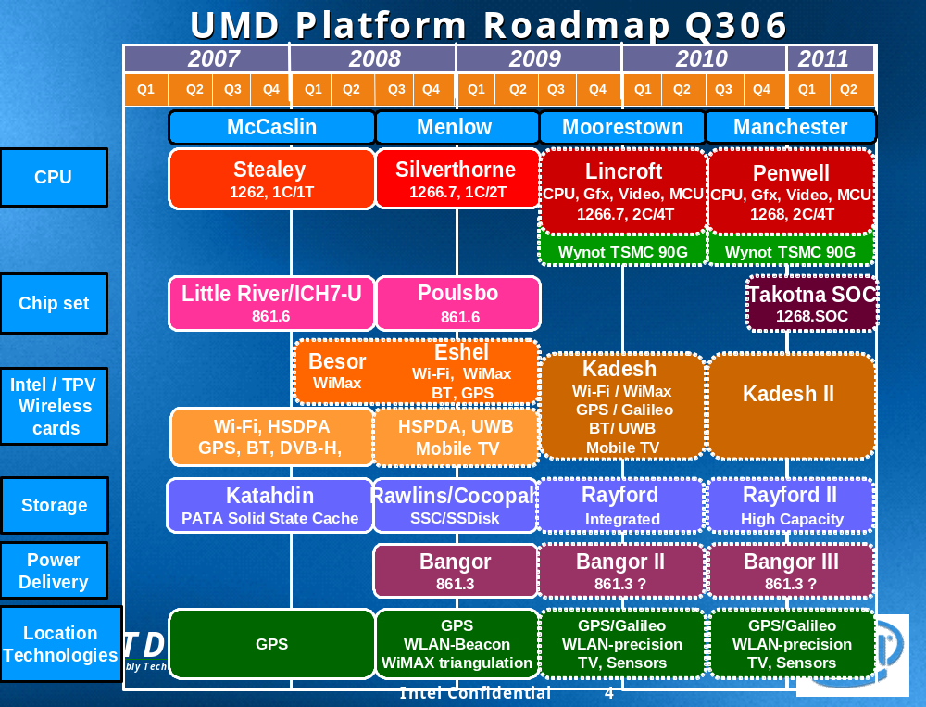
CME Program Engaging Equipment Suppliers and Customers to Ensure Capability in Place to Align with Intel’s Roadmaps.

Slide 13
Mobile Roadmap Assumptions
 | Santa Ynez | Montevina SFF | Calpella | Paso Robles
Year | 2007 | 2008 | 2009 | 2010
Minimum Pitch | 0.593mm | 0.593mm | .593 | 0.5mm
Smallest Ball Diameter | 14 mils | 14 mils | 14mils | 12 mils
Smallest SRO | 300 micron | 300 micron | 300 micron | 250 micron
Smallest PCB Pad Size | 12 mils | 12 mils | 12 mils | 10 mils
Roadmap information is tentative and subject to change

Slide 14
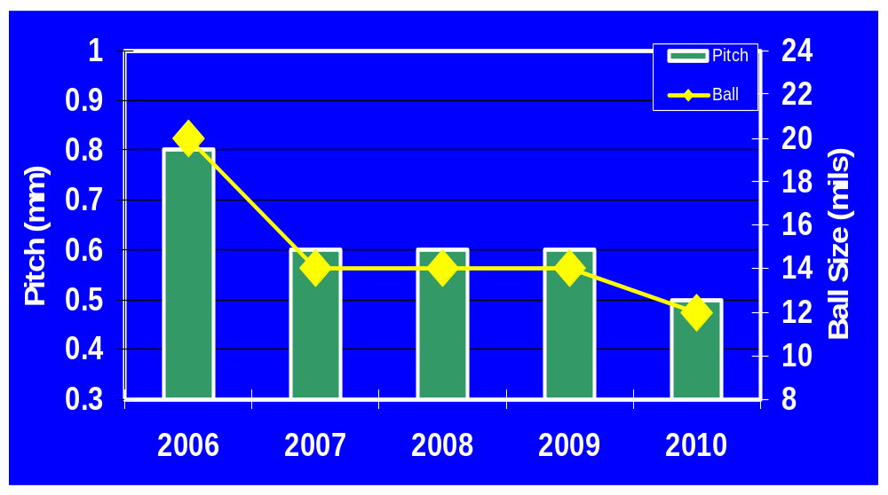
Mobile Pitch and Ball Size Trend
Impact on Placement
ODM ‘06-07 Capability
Equipment Specs
This capability is based on placement machine’s manufacturing specifications.
Pitch at minimum capability will need to be validated.
ODM capability assessment needed at 0.4mm pitch

Slide 15
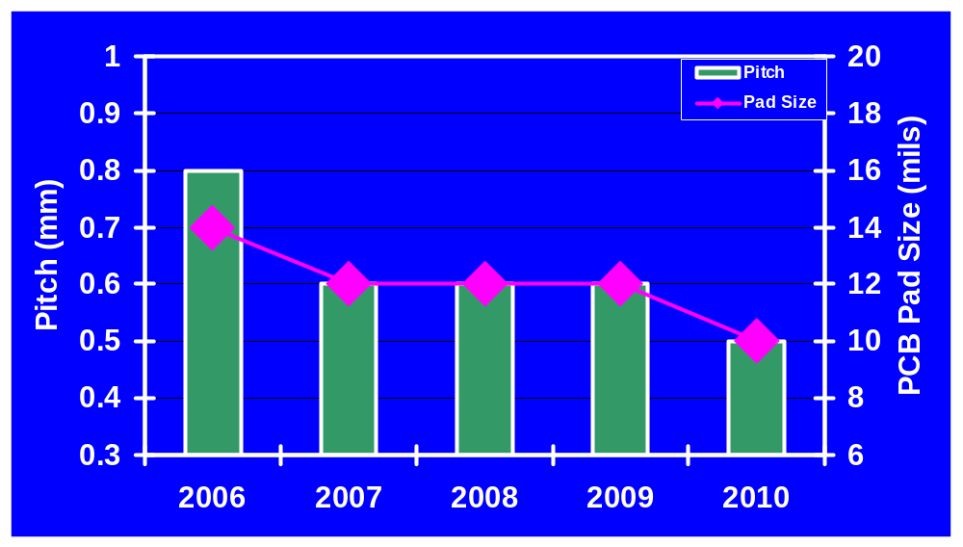
Mobile Pitch and PCB Pad Size Trend
Impact on Rework
Decreasing Capability
Pad lifting becomes more prevalent on smaller diameter pads

Slide 16
Mobile Placement Equipment
 | Quanta (ODM) | Quanta (ODM) | Compal (ODM) | Inventec (ODM) | Wistron (ODM) | Asustek (ODM)
Location | Shanghai QSMC | Shanghai QSMC | Shanghai | Shanghai | Shanghai | Taipei / Shanghai
Placement Machine | Fuji QP341 | Fuji NXT | Universal GSM | Universal GSM | Universal GSM | Universal GSM
Accuracy | 0.066mm @ 3σ | 0.066mm @ 3σ | 0.050mm @ 5σ | 0.050mm @ 5σ | 0.050mm @ 5σ | 0.050mm @ 5σ
Minimum Ball Diameter | 0.250mm (10 mils) | 0.250mm (10 mils) | 0.132mm | 0.132mm | 0.132mm | 0.132mm
Minimum Pitch | 0.400mm | 0.400mm | 0.264mm | 0.264mm | 0.264mm | 0.264mm
Numbers are based on equipment mfg’s specifications
Below .300mm (12 mil) ball diameter, drives ball recognition issue
Quanta’s Fuji machines have first placement capability intercept

Slide 17
Santa Ynez Package Attributes
Package Attribute | Merom uSFF | Crestline uSFF | ICH8-M
Package Technology | 1264 FCBGA6 | 1263 FCBGA7 | WBMMAP
Package Size (mm) | 22x22 | 25x27 | 16x16
Die Size (mm) | 13.8x10.5 | 13.8x10.9 | 7.935x8.087
Die/Substrate-Core (um) | 780/400 | 780/400 | 165/300
Package Layer Count | 6 | 8 | 4
Package Interface | ENIG | ENIG | NiAu
Ball Pitch (mm) | 0.673 | 0.593 | 0.65
Ball Pattern | Interstitial (full grid turned 45 deg) | Variable grid | Full Grid
Ball Count | 956 | 1363 | 576
Ball Diameter (mils) | 14 | 14 | 16
SRO (um) | 390 | 305 (12mil) | 300 (11.8mil)
LF SLI / Ball Composition | SAC405 | SAC405 | SAC405
Corner Design Rule | 26 SCB, 4 corners | 6 SCBs per corner | 1 SCB per corner
Die Shadow nCTF | N-2, N+1 | N, N-2 | None
Based on Package Attributes, Industry Capability Exists for Santa Ynez.

Slide 18
Montevina SFF Package Attributes
Package Attribute | Penryn uSFF | Cantiga uSFF | ICH9-M
Package Technology | 1266 FCBGA8 | 1265 FCBGA9 | WBMMAP
Package Size (mm) | 22x22 | 25x27 | 16x16
Die Size (mm) | 12.5x8 | 10.5x10.5 | ??
Die/Substrate (um) - Product | 780/400 | 780/400 | 165/300
Die/Substrate (um) - TV | 400/400 | 400/400 | 165/300
Package Layer Count | 6 | 8 | 4
Package Interface | NiPdAu | NiPdAu | NiAu
Ball Pitch (mm) | 0.673 | 0.593 | 0.65
Ball Pattern | Interstitial (full grid turned 45 deg) | Variable grid | Full Grid
Ball Count | 956 | 1363 | 576
Ball Diameter (mils) | 14 | 14 | 16
SRO (um) | 390 | 305 (12mil) | 300 (11.8mil)
LF SLI / Ball Composition | SAC405 | SAC405 | SAC405
Corner Design Rule | 26 SCB | 8 SCBs per corner | 1 SCB per corner
Die Shadow nCTF | N-2, N+1? | N, N-2 | None
Based on Package Attributes, Industry Capability Exists for ’08 Mobile Platform
Notes:
ICH9 Die Size – Ron Spreitzer – Sam to f/up

